Slide 1




Kelompok 198
Nemuu
Noval Ardiansyah
Dito Andriano
Devina Lidya
Marsha Zharifah

Slide 2

Sistem Arsitektur
Smartphone
(Kodular)
IoT Platform (Web Dashboard)
Platform
Web Apps
MQTT
Controller
Raspberry Pi
USB
GPIO
GPIO
Camera
(barcode scanner)
Relay Module
LED indicator (closed/open)
DC V
Solenoid 12V (door lock)
Nemuu

Slide 3


Flowchart System
Start
User open the android apps (dashboard)
N
There or Not
User input tag
If nothing, send status “Item Not Found”
Y
If There, do confirmation to access the locker
Send barcode to user
Apps closed?
User scan barcode to cam
scanner
Do : Solenoid on for open the locker
Send status : “Silahkan di ambil barang nya, terima kasih”
Stop

Slide 4




Design Hardware
webcam
cabinet
raspi box
Solenoid lock
LED indicator

Slide 5

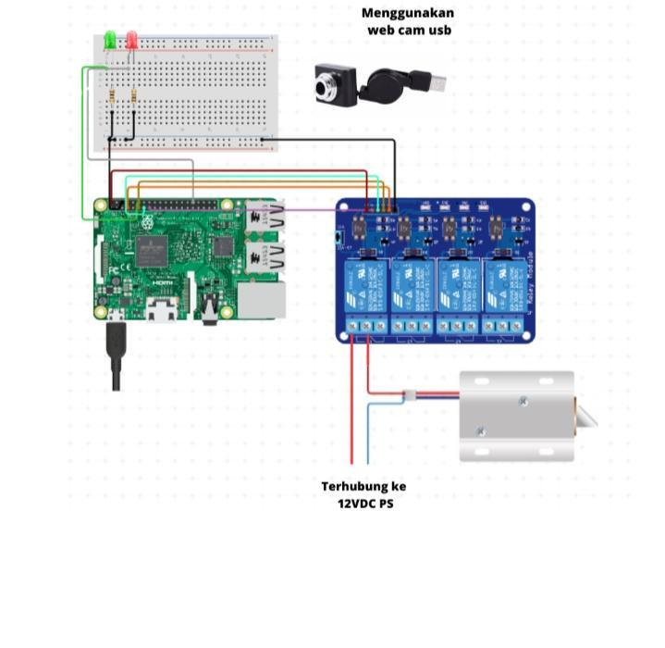
Schematic Design

Slide 6
BoM
NO | Item | Qty | Price/pcs | Total Price (ongkir exclude) | Reference
1 | Raspberry Pi 4 | 1 | Rp. 3.250.000/pcs | Rp 3.290.000 | https://tokopedia.link/rX9swOcoCBb
2 | USB camera | 1 | Rp. 109.000/pcs | Rp 149.000 | https://tokopedia.link/qIphNtfoCBb
3 | Solenoid 5V | 2 | Rp. 30.000/pcs | Rp 120.000 | https://tokopedia.link/Ty4qRFu2DBb
4 | Relay module 2 Ch | 1 | Rp. 44.500/pcs | Rp 84.500 | https://tokopedia.link/WWtXQvy2DBb
5 | LED Panel | 8 | Rp. 8.000/pcs | Rp 104.000 | https://tokopedia.link/Rd6rHNT2DBb
6 | PSU 12V DC Adaptor | 1 | Rp. 10.500/pcs | Rp 50.500 | https://tokopedia.link/gxgGhkOoCBb
7 | Resistor | 8 | Rp. 80/pcs | Rp 40.800 | https://tokopedia.link/UggUCSWoCBb
8 | Box Panel Abu-abu | 1 | Rp. 16.000/pcs | Rp 56.000 | https://tokopedia.link/zurceAgpCBb
9 | Cabinet plastik | 1 | Rp. 175.000/pcs | Rp. 215.000 | https://tokopedia.link/zyJNzLCyCBb
10 | Adaptor 5A | 1 | Rp. 179.000/pcs | Rp. 220.000 | https://tokopedia.link/03rXmU72DBb

Slide 7
BoM
NO | Item | Qty | Price/pcs | Total Price (ongkir exclude) | Reference
11 | PCB matrix | 2 | Rp. 1.350/pcs | Rp. 20.000 | https://tokopedia.link/a3KYhys3DBb
12 | Modem wifi + sim card | 1 | Rp. 400.000 | Rp. 430.000 | https://tokopedia.link/wM9ZbLD3DBb
14 | Module cas | 1 | Rp. 3.000 | Rp. 43.000 | https://tokopedia.link/QQyCLdH3DBb
15 | Kabel jumper | 1 | Rp. 12.000 | Rp. 52.000 | https://tokopedia.link/OTmmmoR3DBb
16 | Battery | 1 | Rp. 153.000 | Rp. 193.000 | https://tokopedia.link/W5Vq22Z3DBb
Total Price |  |  |  | Rp. | 5.067.800

Slide 8



Timeline & Milestone
Planning
Design & Prototyping
Testing
Publish
Sistem Architecture
Flow Chart (System, Controller)
Hardware design
Electronic Schematic design
Bill of Material
Procurement (pembelian)
Hands-on hardware
Coding (IoT Platform, Controller/Raspi, Android)
Assembly (perakitan)
1st prototype
Test & evaluasi
Milestone
- Raspi kirim data ke IoT Platform (UI)
- Raspi - IoT Platform - Android sudah sinkron
- Manual buka/tutup solenoid dengan barcode (generate dari android)
- Generate barcode berdasarkan kecocokan data dengan tag
- ….
Buat ppt produk
Buat video produk
Product presentation
6 Week)
13 Week
(7 week left)

